Slide 1

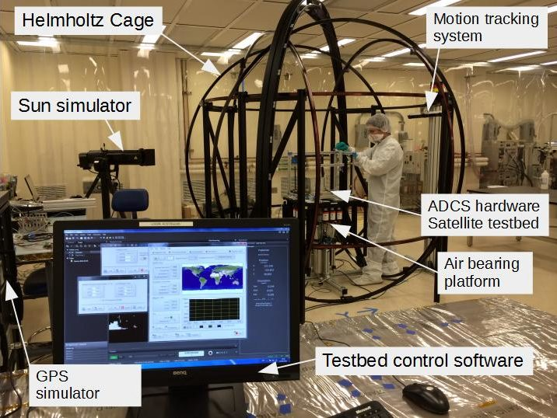
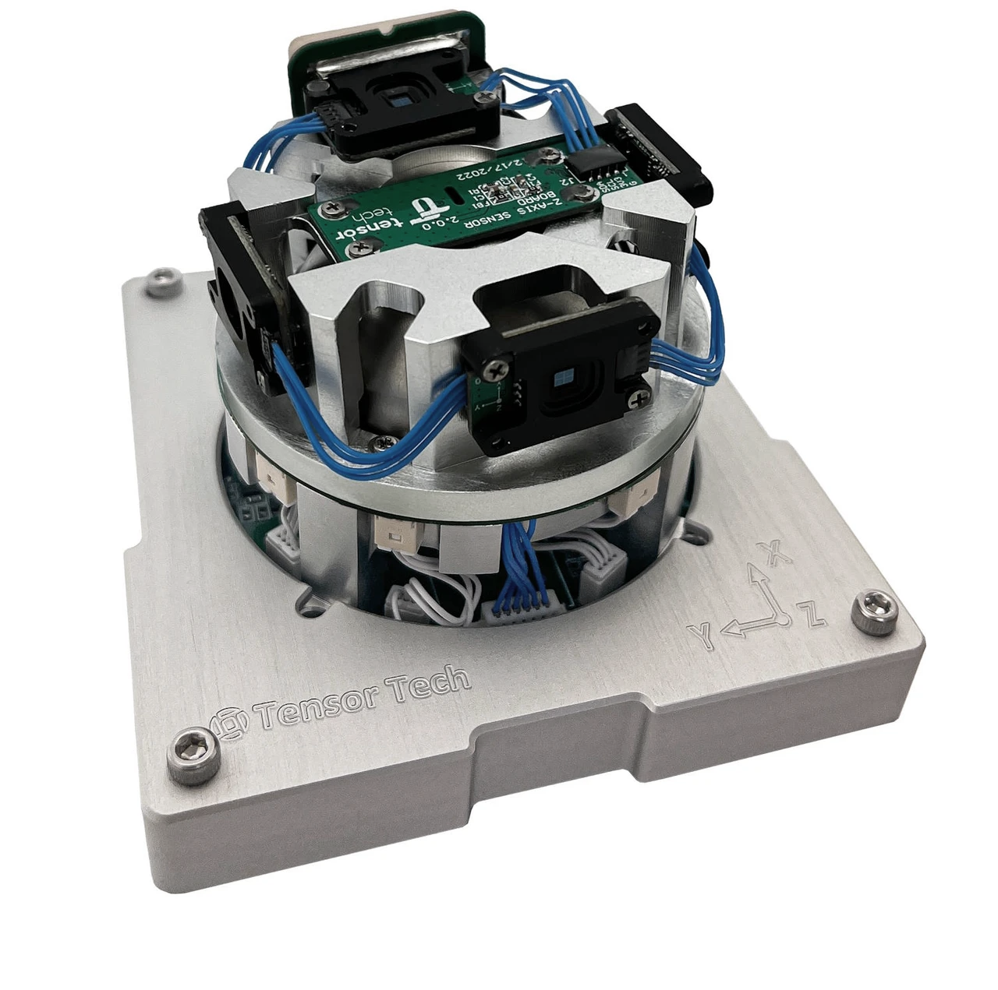
Attitude and Orbit Control System
LECTURE 4
1
Notes:
The last of the four subsystem lectures, and the one that ties the others together — pointing is what the payload, the link and the power system all depend on. 45 minutes, then the final build session.

Slide 2
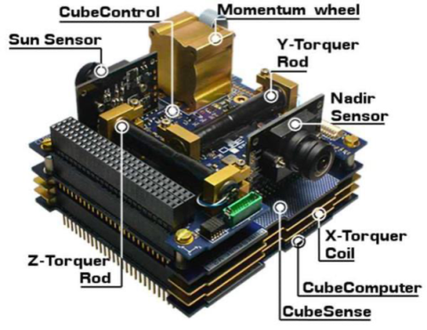
Lecture Outline
Sensor and actuators
ADCS modes
Passive ADCS system
Active ADCS system
Simulation and Test
Propulsion and functions
Exercise
2

Slide 3
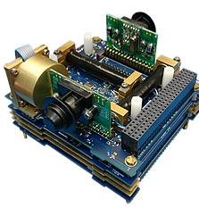
Learning Outcomes
By the end of this lecture, participants will be able to:
  Explain the functions of ADCS sensors and actuators.
  Describe and distinguish different ADCS operating modes.
  Explain passive and active attitude control systems.
  Compare different ADCS sensors and actuators and their applications.
  Understand basic ADCS simulation and testing.
  Explain the functions and applications of spacecraft propulsion.
3

Slide 4


Two modes of Spacecraft Control
Attitude control
Orbital control
Orientation of the vehicle in space
Control of the spacecraft inertial position and velocity, or orbital elements
Orientation
Maneuvers the attitude to the desired direction
Navigation
Determines inertial position and velocity (or orbital elements) and predicts these states
Stabilization
Maintains the attitude to a desired accuracy
Guidance
Controls the trajectory or orbit to meet the desired conditions, based on navigation data
4

Slide 5
Why Attitude Control?
Attitude refers to the orientation of the spacecraft in space. It is not sufficient for a satellite to be in the right orbit: it also needs to be in the right orientation.
The camera
The antenna
The solar panels
What happens if we need to take pictures of the Earth but the camera is pointing toward the Moon?
What happens if we need to send payload data to the ground station but the antenna is pointing toward deep space?
And what if the solar panels are never facing the Sun?
The ADCS has two functions: to determine the satellite attitude using its sensors, and to control the attitude — counteracting disturbance torques, and manoeuvering to meet the mission requirements — using its actuators.
Definition: ESA Science, Spacecraft glossary — sci.esa.int. Remaining text: Lecture 08.
5
Notes:
All three questions come from Lecture 08 and are worth asking out loud rather than reading. Two minutes.

Slide 6
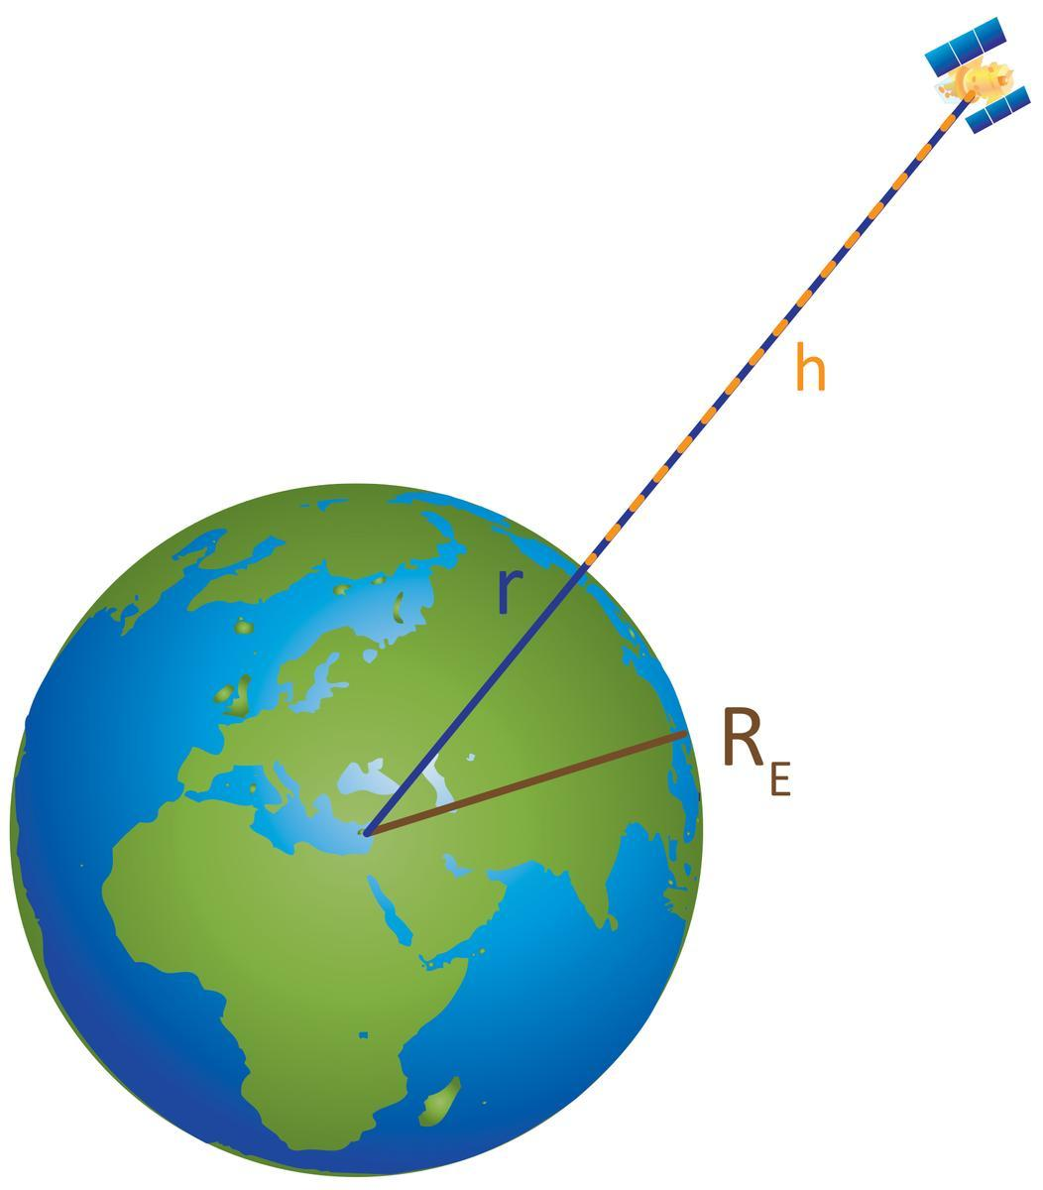
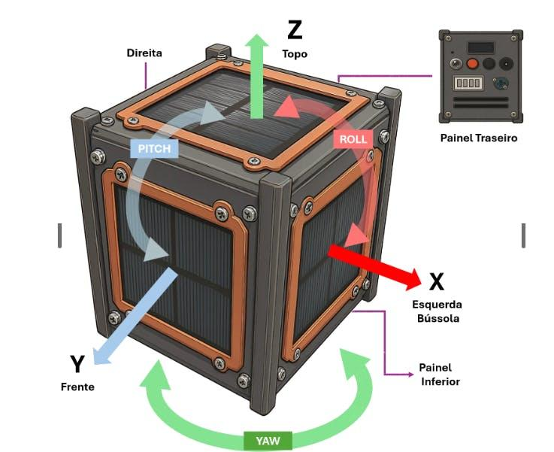
Attitude vs Altitude
Attitude
Altitude
6

Slide 7
Common Acronyms
ACS – Attitude Control System
ADCS – Attitude Determination & Control System
AGS – Attitude Ground System
AOCS – Attitude & Orbital Control System
GNC – Guidance, Navigation & Control
We will use
ADCS (attitude) and GNC (orbit)
7

Slide 8
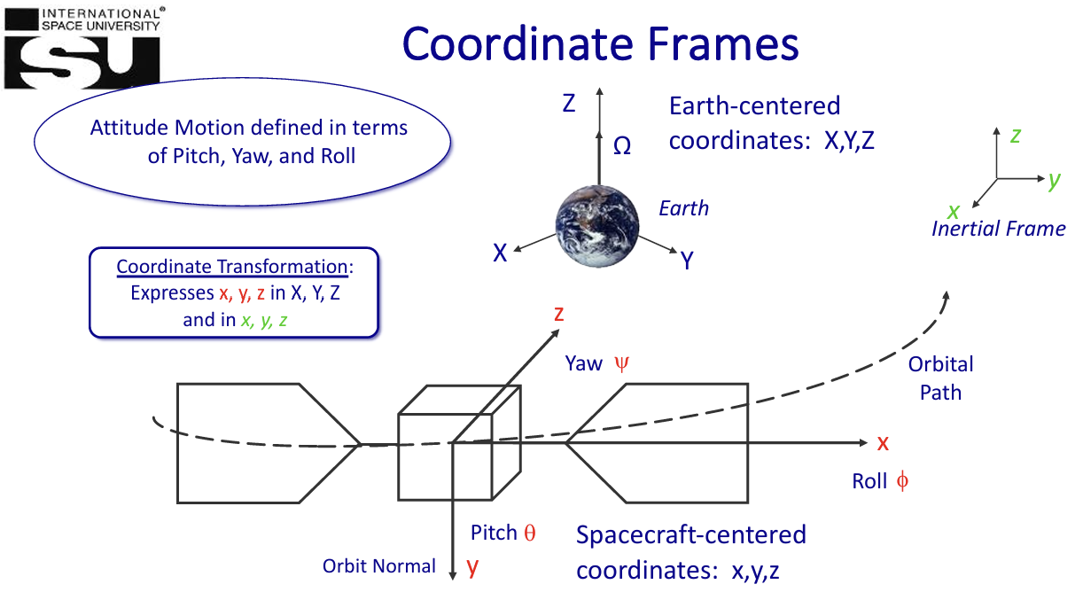
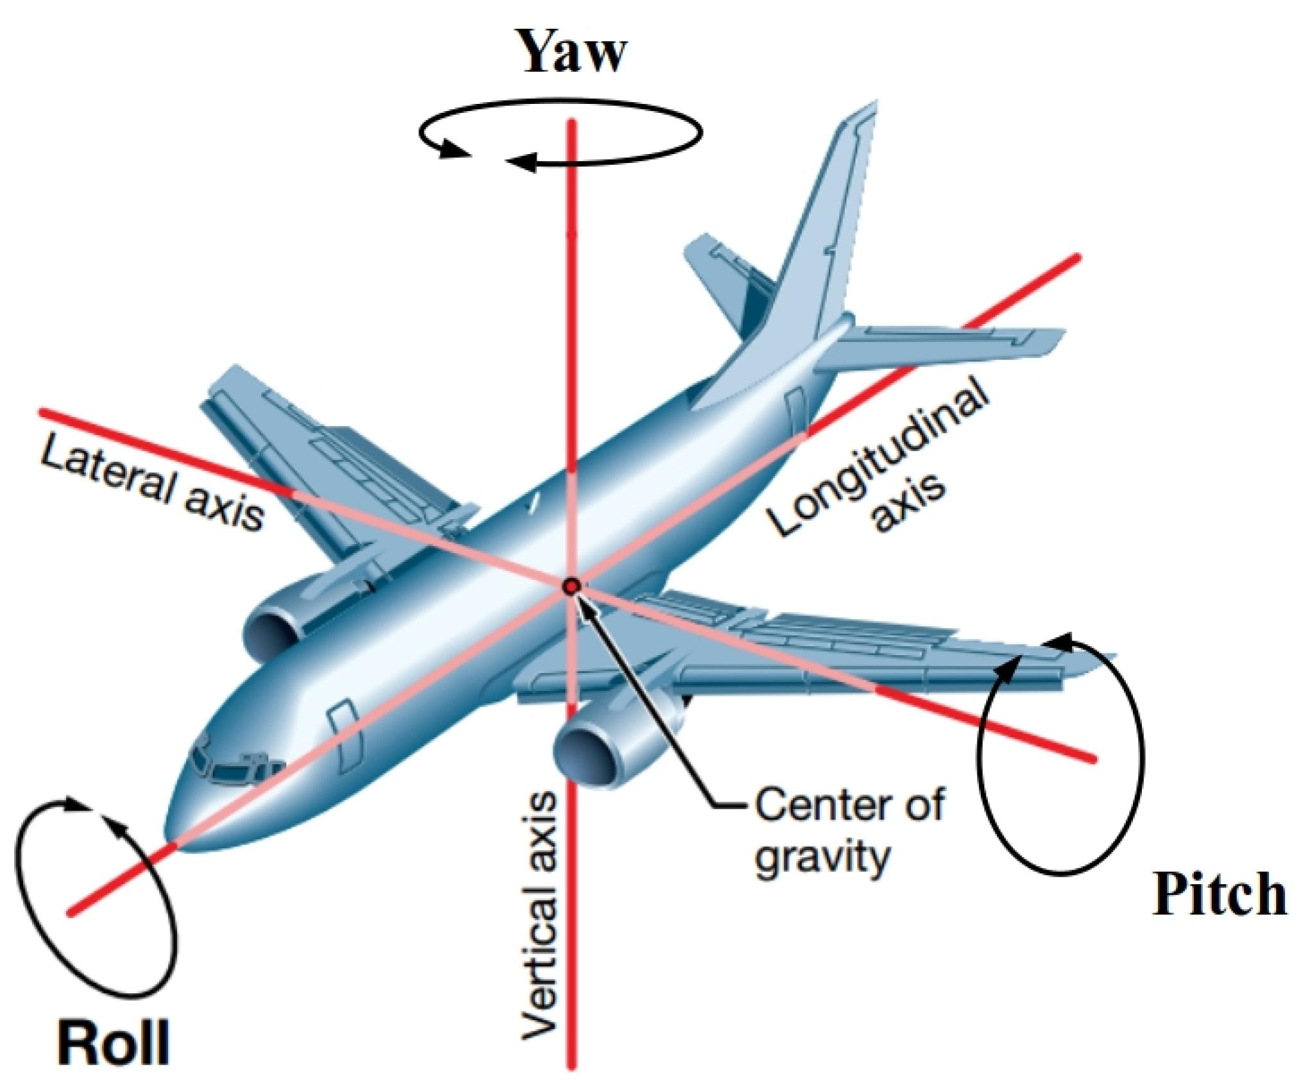
8

Slide 9



Key Control Terms
Input
Output
Feedback
Instructions or commands used by the control algorithm to generate an action by the spacecraft or rocket. The action is carried out by actuators.
What the system is doing dynamically in response to the input or to other disturbances. It is measured by sensors.
Information obtained from the sensors and used by the controller to generate actuator commands (the control signal).
9

Slide 10
Sensors (Attitude Determination)
These provide information about the spacecraft’s orientation and angular velocity.
  Sun sensors → detect Sun direction for coarse orientation.
  Earth sensors (horizon sensors/infrared sensors) → measure Earth’s horizon to point nadir or in the direction of the earth
  Star trackers → very precise attitude determination by comparing star fields with onboard catalogues.
  Magnetometers → measure Earth’s magnetic field direction for coarse attitude reference.
  Gyroscopes/Inertial Measurement Units (IMUs) → measure angular velocity and short-term orientation changes.
10

Slide 11
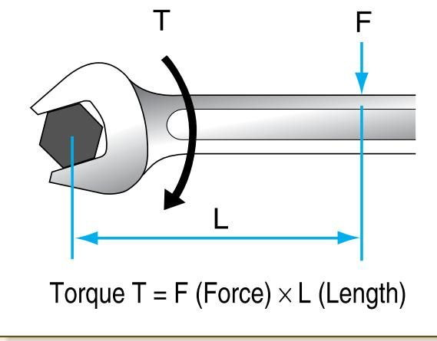
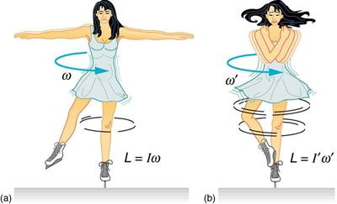
Torque, Inertia & Angular Momentum
To decide how much torque is needed and how to apply it, three physical quantities have to be defined first.
Torque
Torque is a force applied at a distance about a point. Torque is creating a rotation and not a linear movement.
Moment of inertia
Torque is a force applied at a distance
A body is harder to turn if it has a higher moment of inertia. The moment of inertia is bigger if the mass is further away from the centre of rotation.
Angular momentum
The product between inertia and angular velocity. The rate of change of angular momentum of a body is equal to the torque applied to it, and angular momentum is conserved if there is no external torque.
Angular momentum is conserved when no external torque acts
Pointing and Attitude Control
5
11
Notes:
Lecture 08 puts it this way: if figure skaters close their arms while they are spinning, their inertia decreases, since the mass is getting closer to the centre; since angular momentum is conserved, the angular velocity has to increase. Satellites change their orientation in space in the exact same way. Lecture 08 also states that reaction and momentum wheels, which need a high moment of inertia, are built with the mass located as far away from the centre as possible.

Slide 12
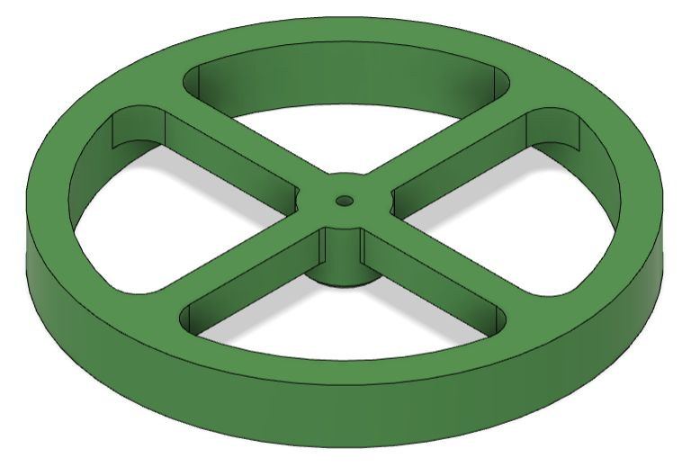
Actuators (Attitude Control)
Function: Generate forces/torques to orient or stabilize the satellite.
These actively change or maintain spacecraft orientation.
  Reaction wheels → store angular momentum to control pitch, yaw, roll precisely.
  Control Moment Gyroscopes (CMGs) → generate large torques for fast maneuvering.
  Thrusters (cold gas or chemical) → provide torque and momentum dumping; also used for orbit control.
  Magnetorquers (magnetic torque rods) → generate torque by interacting with Earth’s magnetic field.
  Spin stabilization → the spacecraft body itself acts as a gyroscope.
12

Slide 13
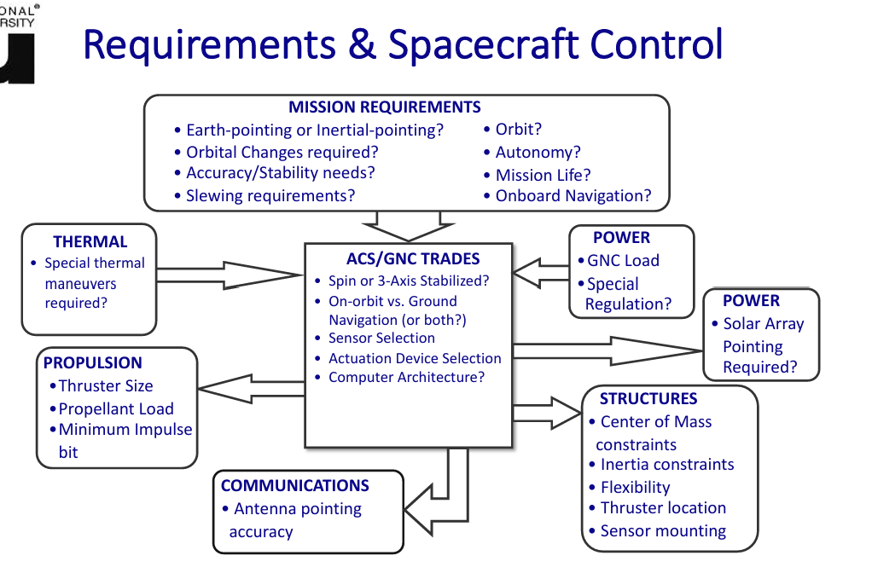
13

Slide 14
Two Basic Methods of Control
Open Loop Control
no feedback from sensor
actuator inputs are not influenced by a controller
Closed Loop Control - Feedback
uses the sensor measurements of the output
output (sensor) measurements used by controller
controller generates input (control signal) to the system based on outputs fed back through the controller
14

Slide 15
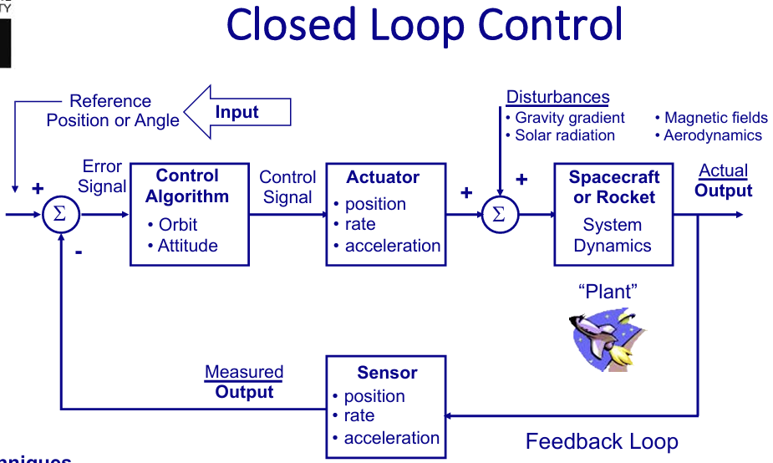
15

Slide 16
ADCS Modes
1. Detumbling Mode
Activated right after launch or separation.
Objective: Remove residual angular rates from the launch vehicle separation.
Typically uses magnetorquers or thrusters for stabilization.
2. Sun Acquisition / Safe Mode
Spacecraft aligns its solar panels toward the Sun to ensure power generation.
Ensures survival while awaiting further commands.
3. Earth Acquisition / Nadir-Pointing Mode
Satellite orients itself so that instruments or antennas face Earth.
Common for Earth-observation or communication satellites.
16

Slide 17
ADCS Modes
4. Inertial Pointing Mode
  Spacecraft maintains orientation fixed with respect to inertial space.
  Useful for astronomy or scientific payloads observing deep space.
5. Tracking / Target Pointing Mode
  Satellite continuously points to a moving target (e.g., ground station, star, planet, other spacecraft).
  Requires precise sensors and actuators.
6. Momentum Management Mode
  Used when reaction wheels or gyros reach speed limits due to accumulated momentum.
  Magnetorquers or thrusters are activated to dump momentum.
17
Notes:
Inertial space = the star-fixed reference frame (non-accelerating, non-rotating), used for precise spacecraft orientation and navigation.

Slide 18
Passive Attitude Determination and Control
Uses natural forces (gravity, magnetic field, aerodynamic drag, solar pressure) to stabilize or orient the satellite.
Key Features:
  No moving parts or powered actuators.
  Low complexity, lightweight, and reliable.
  Slower response and less precise control.
Examples:
  Gravity-gradient stabilization: Using Earth’s gravity to align the satellite’s long axis toward Earth.
  Magnetic torquers (passive magnets): Aligning with Earth’s magnetic field.
  Spin stabilization: Rotating the spacecraft to keep it stable (like a gyroscope).
18

Slide 19
Example of ADCS PBS
1.1.1
Satellite Bus
Layer 2
Layer 3
1.1.1.1
STR 1U
1.1.1.2
Propulsion
1.1.1.3
ADCS
1.1.1.4
EPS
1.1.1.5
COMM
1.1.1.6
OBC/
CD&H
1.1.1.7
Thermal
Layer 4
1.1.1.3.1
Attitude Determination
1.1.1.3.2
Passive Attitude Control
Layer 5
Micro-controller
GPS
3-axis Magnetometer
3-axis Gyro
Accelerometer
Permanent Magnet
Hysteresis Damper
19
Notes:
Gyroscopes in ADCS are used to measure the rate of rotation of the spacecraft around its axes, helping track orientation changes over time.
A magnetometer in ADCS measures the magnetic field strength and direction, typically of Earth’s magnetic field. By comparing the measured magnetic field vector to a model, the spacecraft can determine its orientation relative to Earth.
Accelerometers measure linear accelerations, which help in detecting translational forces acting on the spacecraft, such as gravity or atmospheric drag in LEO.
Permanent magnets can be used as a passive attitude control component, especially in simpler ADCS designs. They align the spacecraft with Earth’s magnetic field, providing a stabilizing effect that helps maintain a desired orientation.
Hysteresis dampers provide passive damping, reducing oscillations and stabilizing the spacecraft’s attitude over time. They use materials with hysteresis properties (often magnetic materials) to absorb and dissipate energy as the spacecraft rotates.

Slide 20
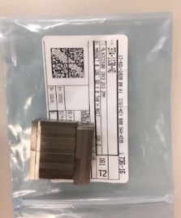
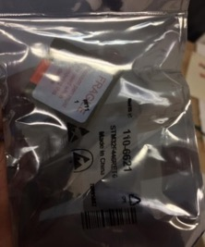
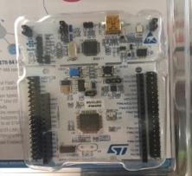
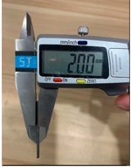
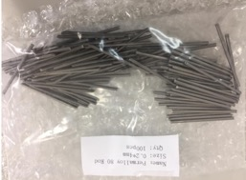
Passive ADCS Components
Magnetometers & Gyroscopes
ADCS MCU
Permanent magnets
Hysteresis damper
20

Slide 21
Block Configuration (e.g. Passive System)
GS
Attitude determination
GPS
3 axis Gyroscope
L3GD20TR
Magnetometer
MMC5883ma
Solar cell
COM
SPI
I2C
UART
UART
ADCS MCU
ARM STM32F446RET6
UART
OBC
Mission boss
Flash Memory
SPI
Hysteresis damper: Passively dissipates rotational energy to reduce residual oscillations and stabilize the satellite's attitude.
Permanent magnet: Aligns the satellite with Earth's magnetic field to provide passive attitude control.
Permanent
magnets
Hysteresis Damper
Attitude Stabilization
21

Slide 22
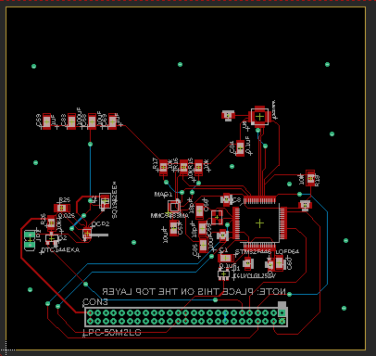
ADCS BBM Schematic
22

Slide 23
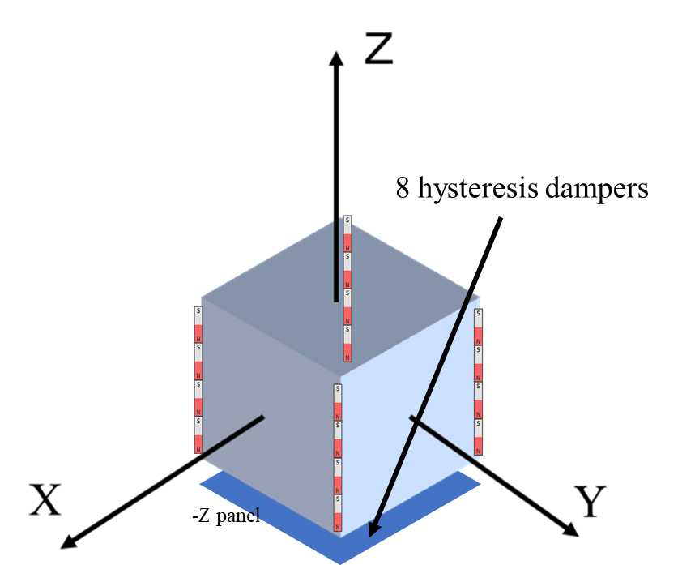
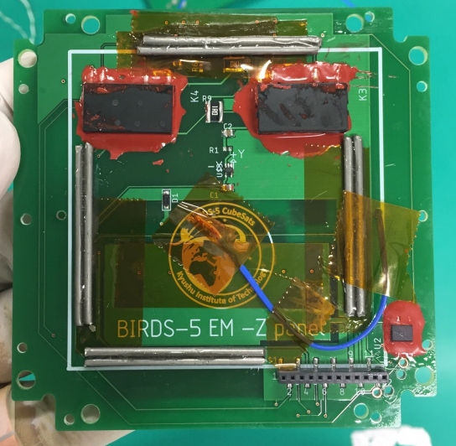
Passive Attitude Control
Hysteresis damper
Hysteresis dampers are mounted on –Z panel
They reduce satellite oscillation to magnetic field
23

Slide 24
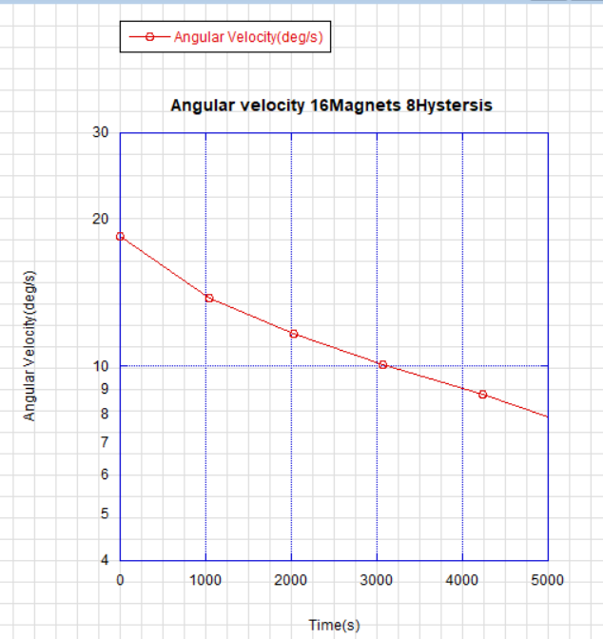
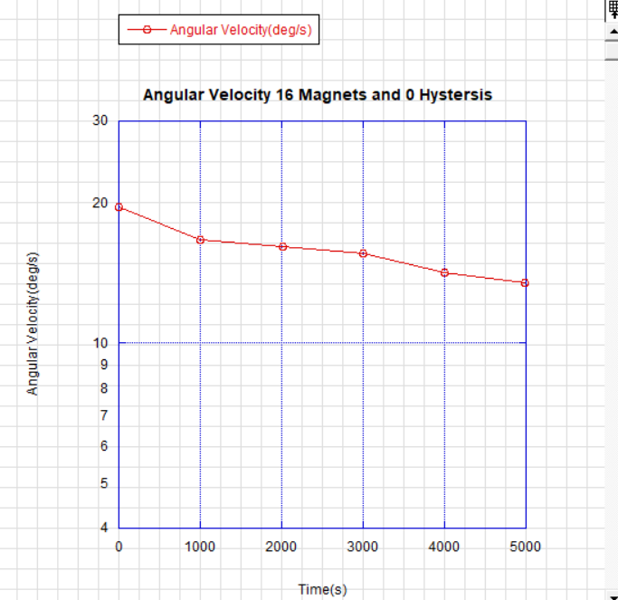
Hysteris Damper Test Results
Hysteresis dampers are working well
24

Slide 25
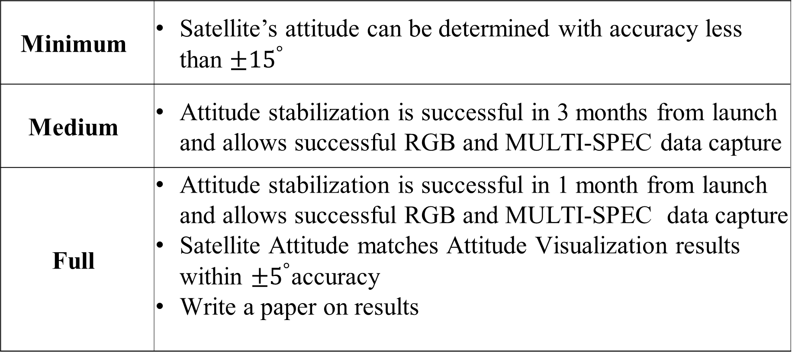
Success Levels
Minimum |  | Satellite’s attitude can be determined with accuracy less than $±{15}^{°}$
Medium |  | Attitude stabilization is successful in 3 months from launch and allows successful RGB and MULTI-SPEC data capture
Full |  | Attitude stabilization is successful in 1 month from launch and allows successful RGB and MULTI-SPEC data capture Satellite Attitude matches Attitude Visualization results within $±5^{°}$accuracy Write a paper on results
25

Slide 26
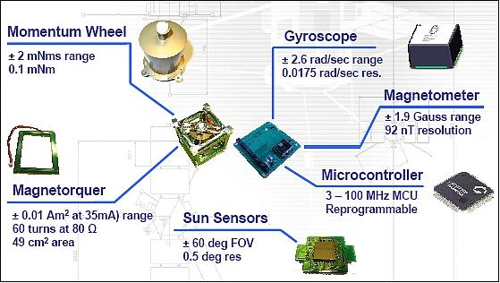
Active Attitude Determination and Control
Uses sensors + actuators actively controlled by on-board computers to determine and adjust orientation.
Key Features:
  Requires power and complex control algorithms.
  Provides high precision and rapid adjustments.
  Higher cost, weight, and system complexity.
Examples:
  Reaction wheels and control moment gyroscopes for fine pointing.
  Thrusters for torque or momentum dumping.
  Magnetorquers (active type): Actively generating magnetic dipoles to interact with Earth’s field.
  Star trackers, gyros, sun sensors for attitude determination.
26

Slide 27
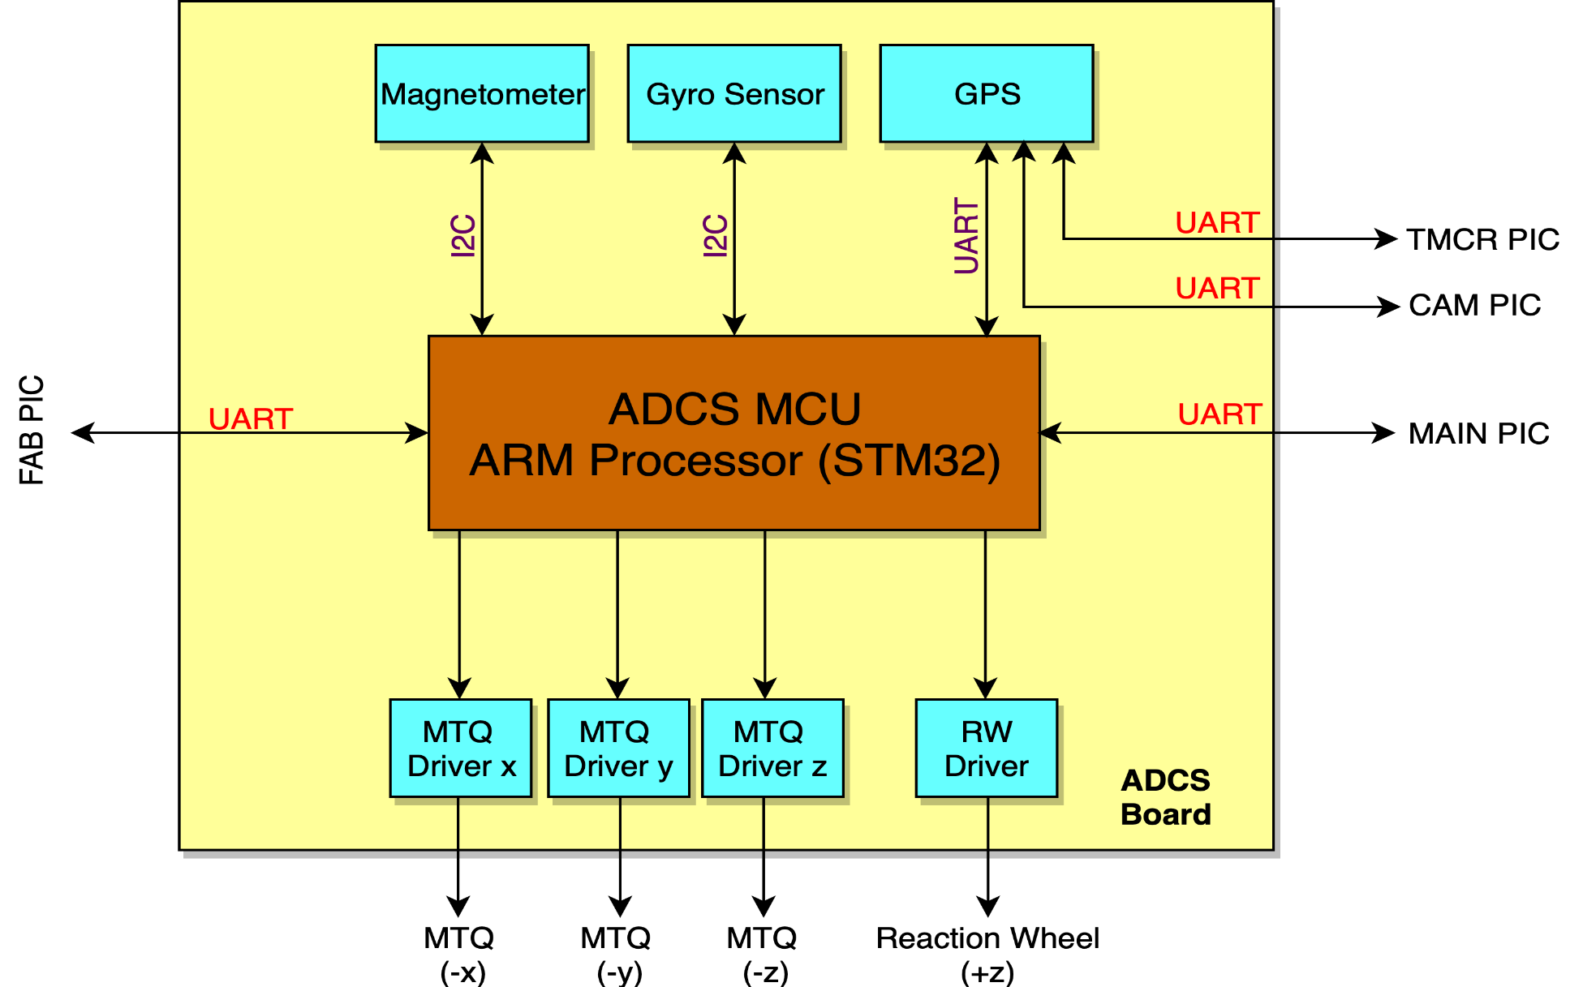
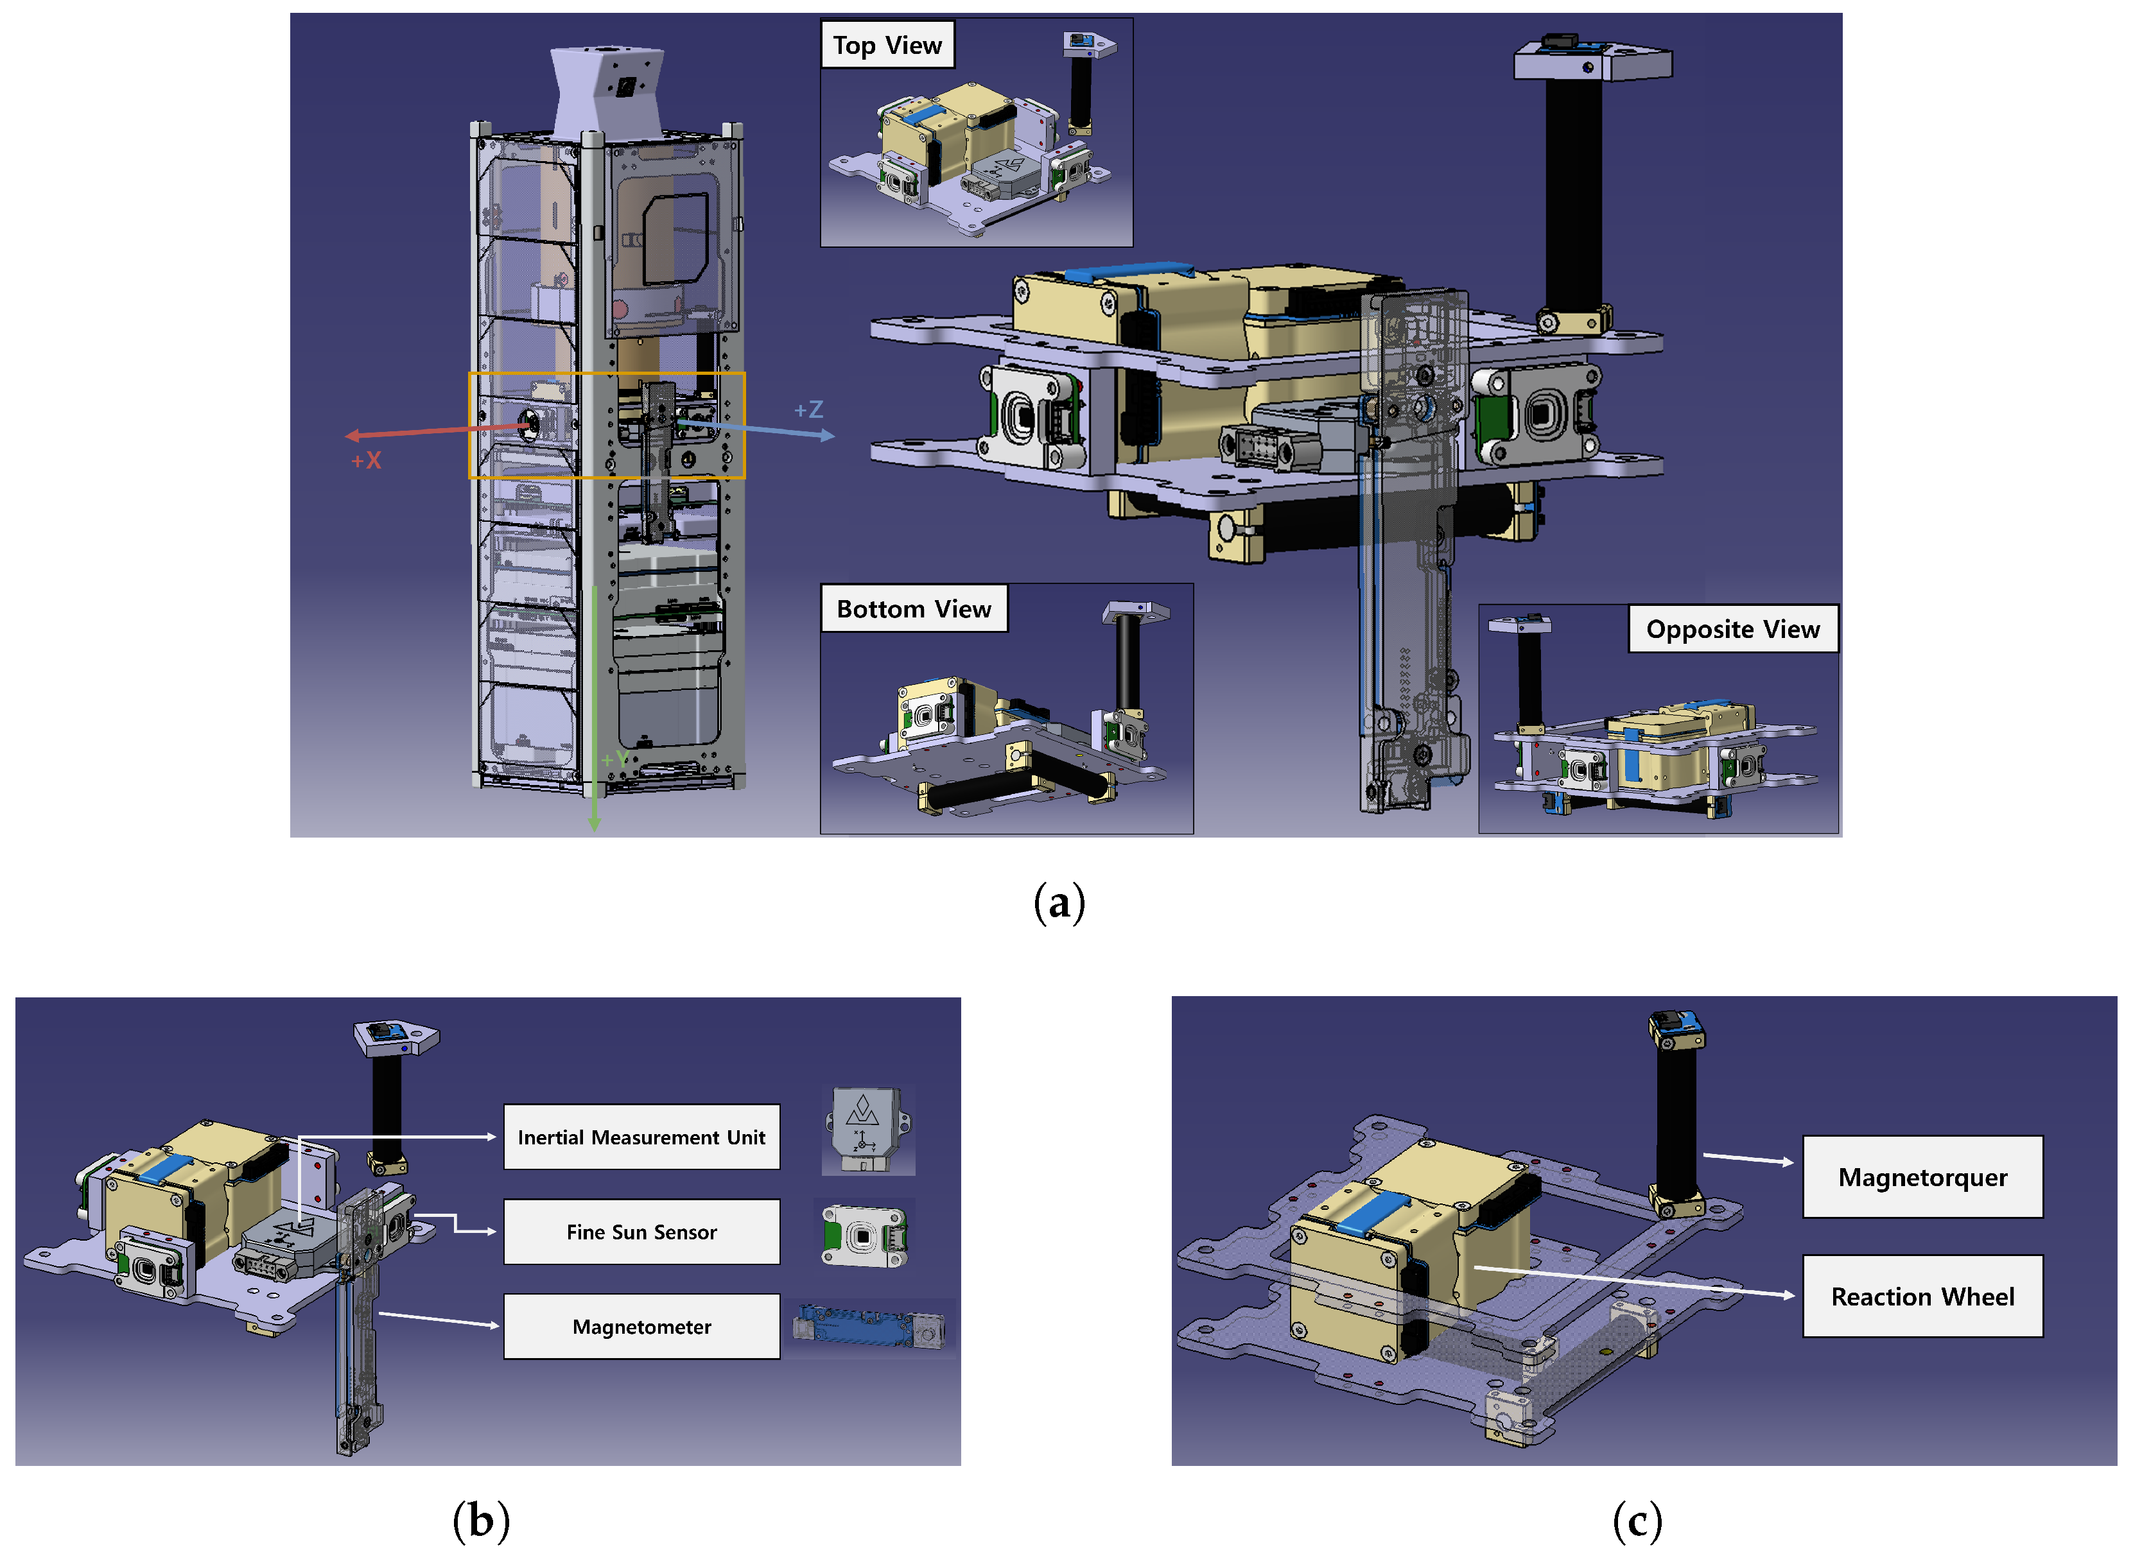
Active ADCS
SPI
27

Slide 28
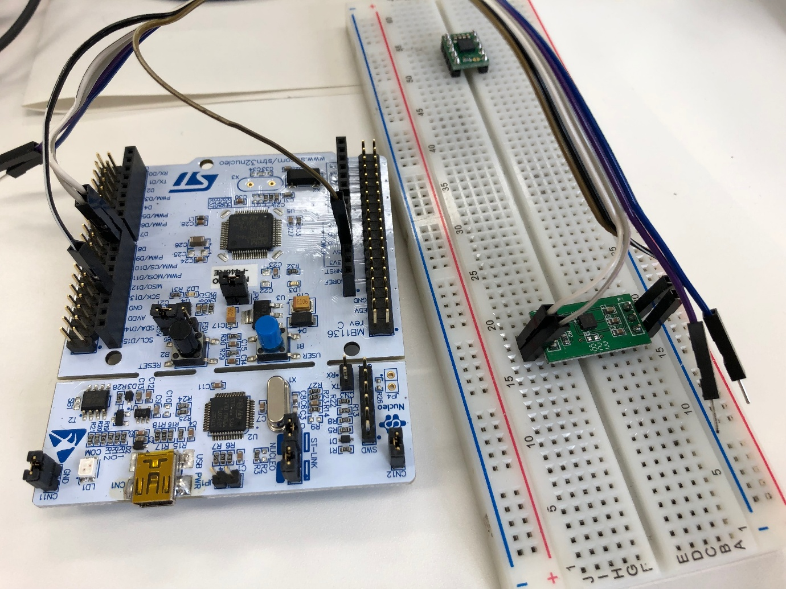
Magnetic Field Test
Read magnetic field value via I2C
And show with UART
Magnetometer (µT):
X: 12.1
Y: -36.4
Z: 28.7
Total Field: 49.3 µT
Typical Magnetometer Readings for CubeSats in LEO (200–600 km):
Parameter | Expected Range
Magnetic Field (X, Y, Z) | -60 µT to +60 µT (microtesla)
Total Field Strength | ~25 µT to 65 µT
Typical Average Value | ~45 µT (depends on orbital position)
28

Slide 29
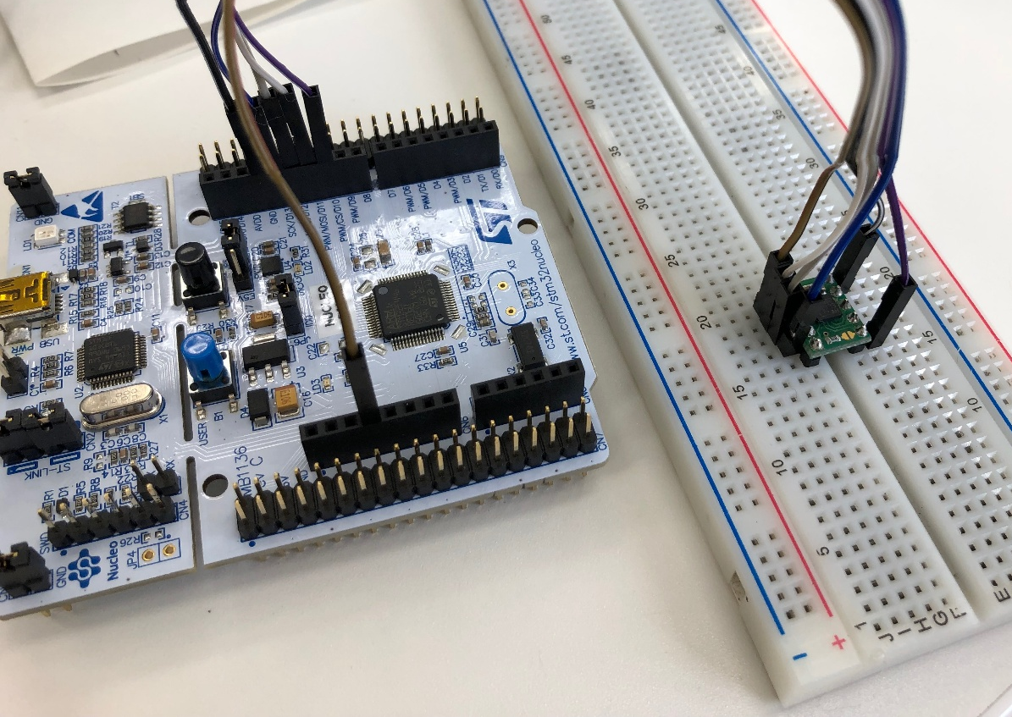
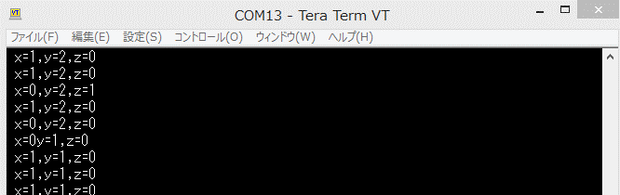
Gyroscope Tests
.
Gyroscope (°/s):
X: 0.12
Y: -0.03
Z: 0.08
Gyroscope function test
Connect with SPI and Show via UART
Typical Ranges in LEO:
Condition | Expected Angular Velocity | Description
Post-deployment (tumbling) | ±2 to ±20 °/s | Immediately after release from the deployer; uncontrolled motion.
During detumbling | ±0.5 to ±5 °/s | As ADCS tries to slow down rotation.
Nominal (stable pointing) | ±0.01 to ±0.5 °/s | Controlled, steady-state operation (e.g., for imaging, comms).
Actuated maneuvering | ±0.5 to ±2 °/s | During intentional re-orientation.
Sensor noise floor | ±0.001 to ±0.01 °/s | Depends on sensor resolution and filtering.
Small values indicate slow, stable rotation (ideal for imaging, comms).
Large values (> 1–2 °/s) suggest spinning/tumbling—often right after deployment
29

Slide 30
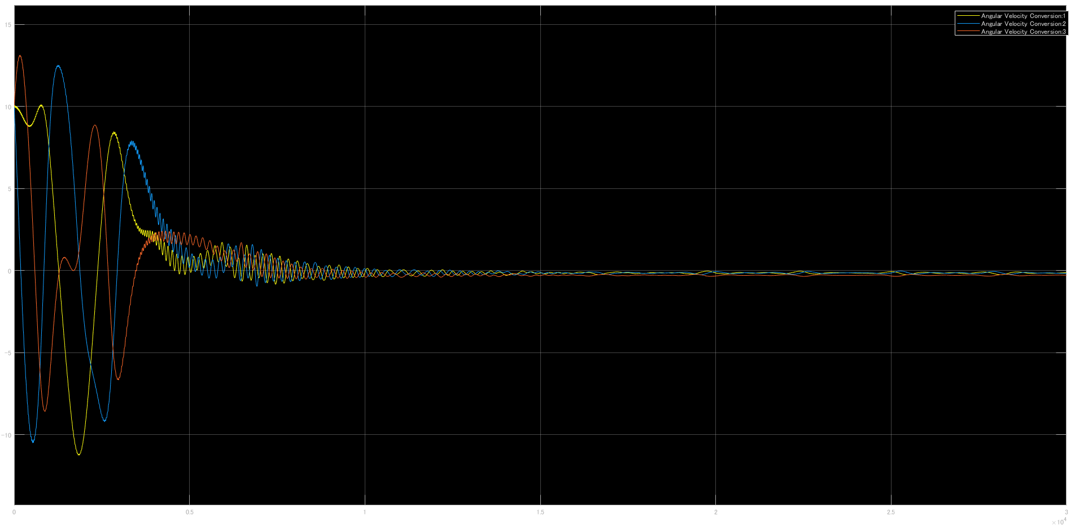
Simulation Results
Simulation Results[Angular Velocity]
Angular velocity [deg/s]
Time [sec]
30

Slide 31
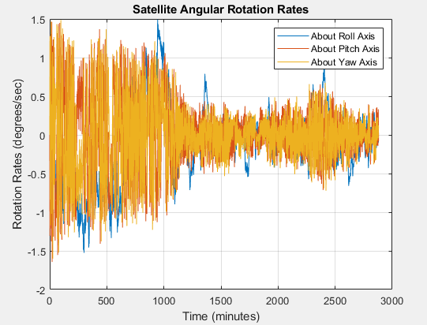
ADCS MATLAB Simulations
31

Slide 32
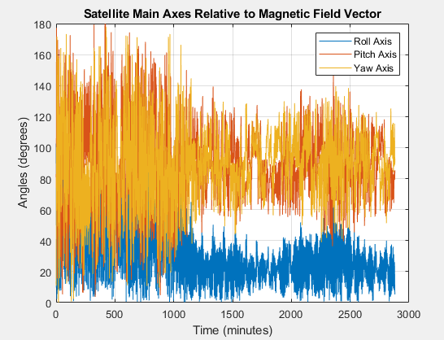
ADCS MATLAB Simulations
32

Slide 33
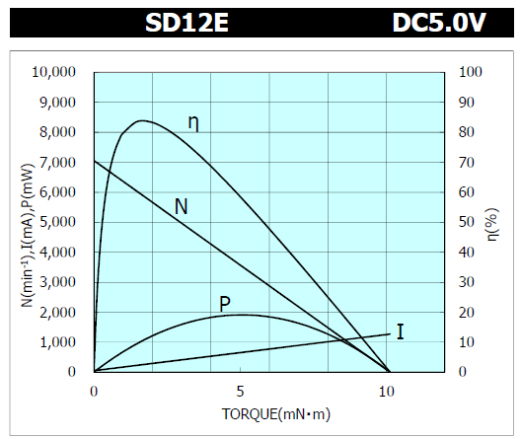
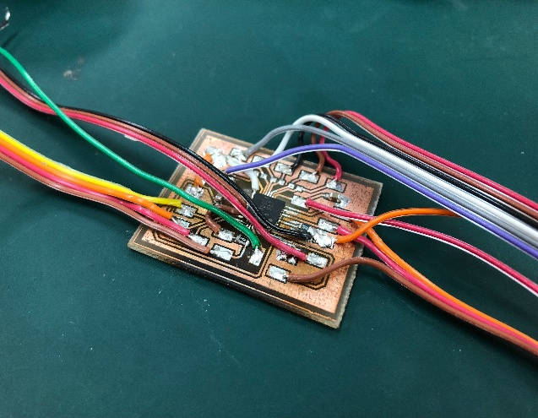
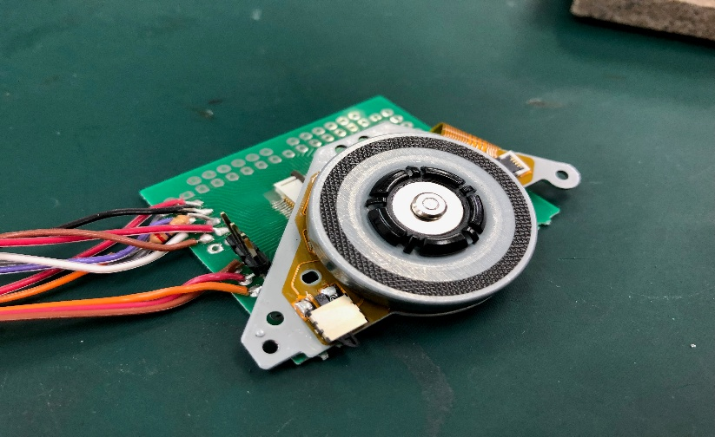
Reaction Wheel Turn Test
Reaction Wheels turn test
5V 6000rpm
Turn speed control function checked.
Reaction Wheel Test Parameters vs Torque
Parameter | Symbol | Unit | Expected Trend vs Torque | Typical Values (CubeSat 3U–6U class)
Speed | N | RPM (rev/min) | decreases linearly with torque | 1000–6000 RPM
Current | I | mA | Linearly increases with torque | 50–300 mA
Power | P | mW | Increases (P = V × I) | 200–1500 mW
Efficiency | ηₙ | % (mechanical) | Non-linear, peaks at optimal low to mid torque | 20%–70%
33

Slide 34
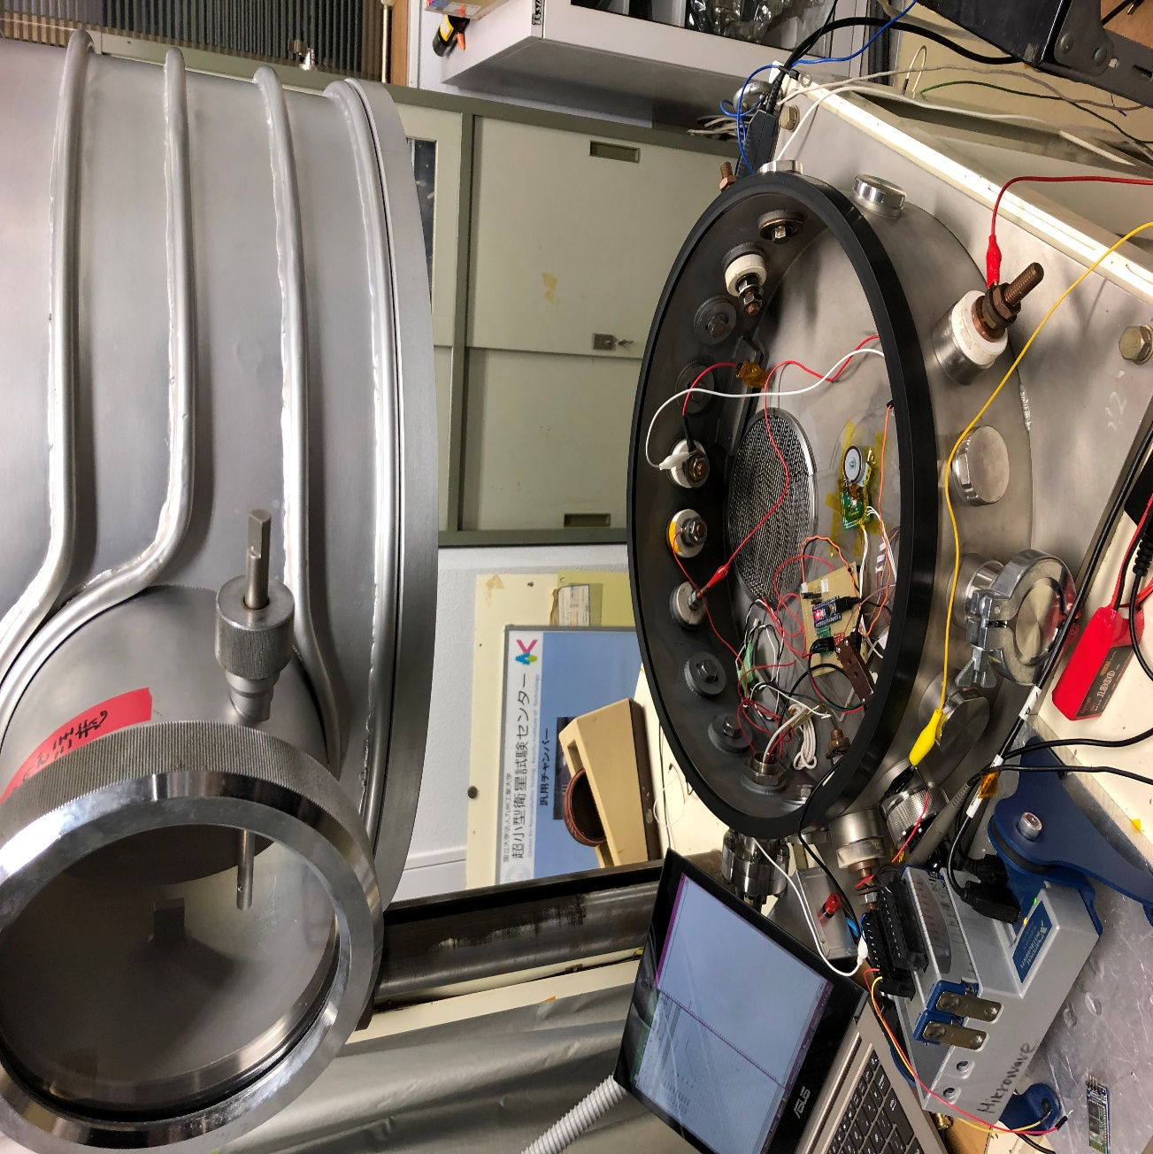
Reaction Wheel Test
Reaction Wheels vacuum environment test
34

Slide 35
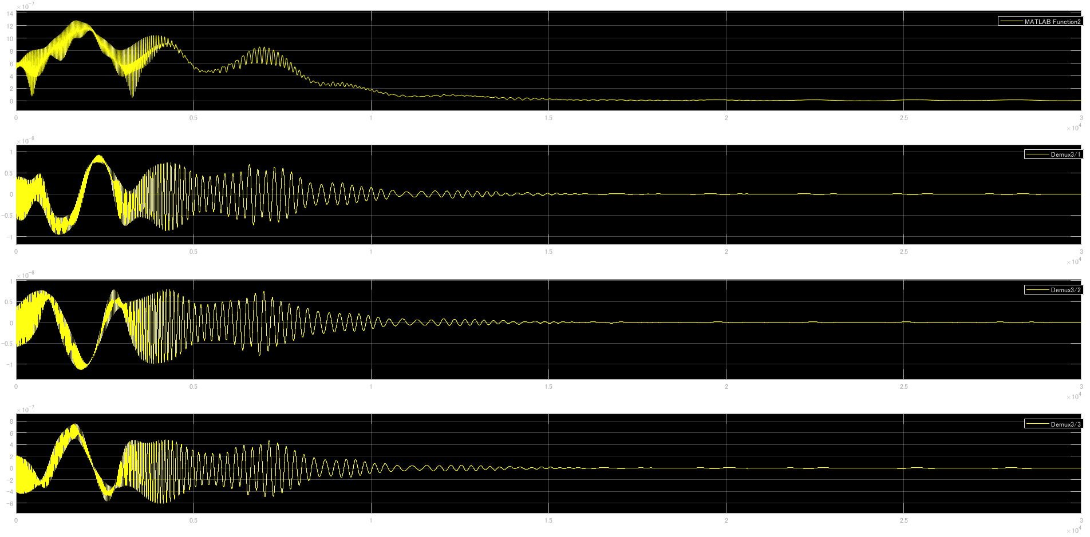
Simulation Results
Simulation Results [Generated Torque]
[Nm]
Time [sec]
35

Slide 36
Fault Mode Effect Analysis
Fault | Effect | Solution
GPS failure | Location data is not available | Get the position using TLE data
MTQ driver IC failure | One MTQ failure | Stabilize by other two MTQs
Two Driver ICs failure | Two MTQs failure | Stabilize by one MTQ
All(three) Driver ICs failure | Three MTQs failure | Switch to alternative actuators (e.g., reaction wheels) or enter safe hold mode
Solar cell information failure | Attitude determination error | Fall back to magnetometer-only or star tracker data (if available)
ADCS MCU failure | ADCS mission fails | Reset the power of ADCS MCU
Reaction Wheels failure | Pointing mission fails | Stop it and Stabilize by MTQ
36

Slide 37
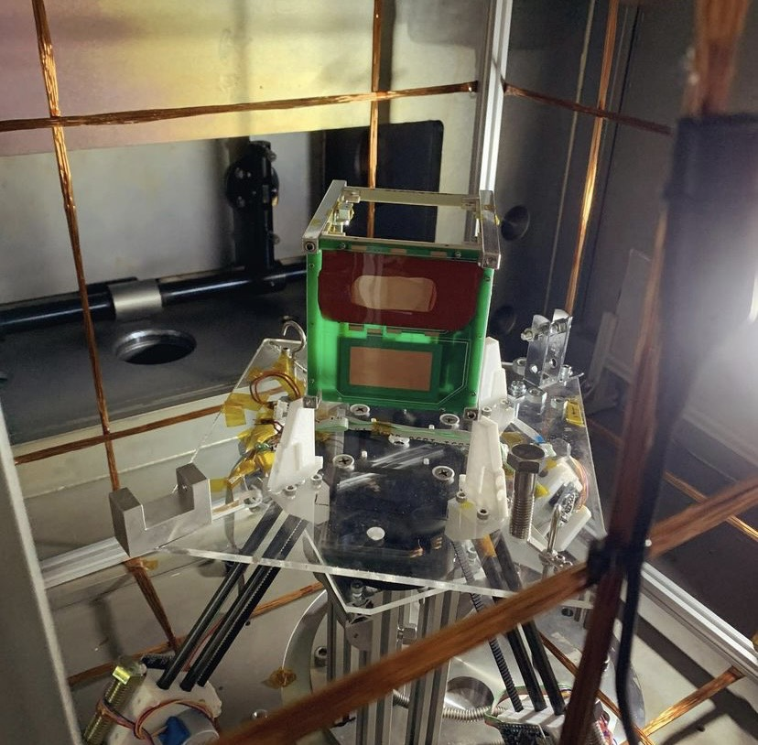
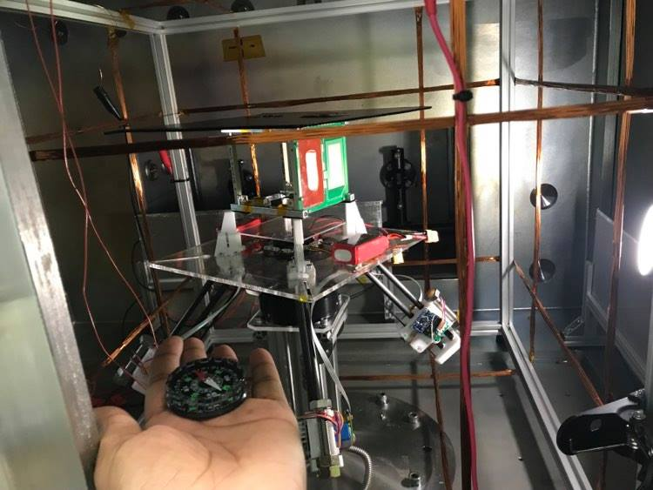
Air Bearing Table Test
An air-bearing table simulates the microgravity and free-floating environment of space on the ground.
It allows a satellite or its mock-up to rotate freely with minimal friction in 2 or 3 axes.
This setup is used to test and validate ADCS algorithms and hardware in a realistic, frictionless rotational environment before launch.
Helps observe satellite behavior during detumbling, pointing, or maneuvers in a controlled lab setup.
Air bearing table
This table rotate with very few friction
Satellite stopped with pointing the
direction we expected
37

Slide 38
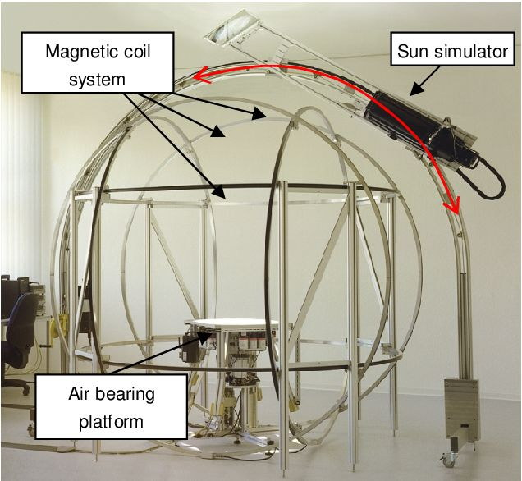
Attitude System Testing
Once the ADCS is designed and the control method and algorithms are coded, it is necessary to test the correct functioning of the system.
Spherical air bearing
Responsible to generate a frictionless movement, to simulate the orbit conditions.
Magnetic coils
The magnetic field of the Earth is simulated by magnetic coils.
Sun simulator
A Sun simulator is put in place, so the Sun sensors have a real source to measure.
An attitude control test facility
Pointing and Attitude Control
38
Notes:
Two minutes. The three items are Lecture 08's. The idea worth leaving behind is that the orbit environment is reproduced piece by piece, because it cannot be reproduced as a whole.

Slide 39
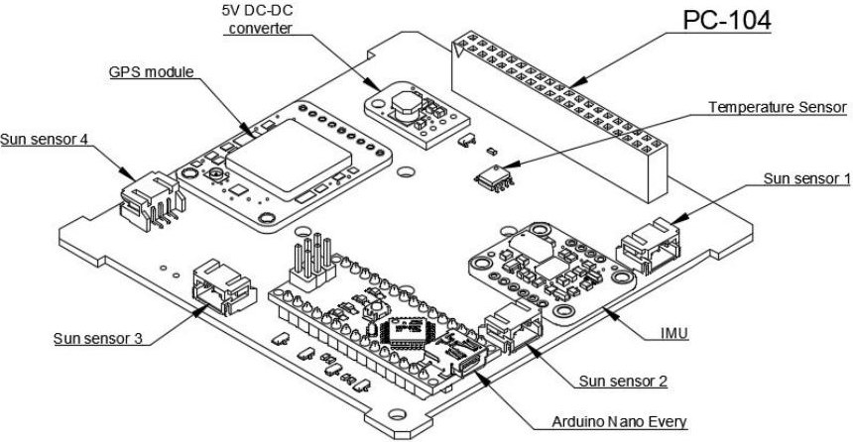
A CubeSat Attitude Board
Determination and control on a single PC-104 board, at the smallest practical scale.
Inertial measurement unit
Rotation rates about each axis
Sun sensors
One per side, giving direction to the light source
Navigation module
Position, used during ground testing
Reaction wheel and motor
The actuator on the board
Dedicated processor
Attitude determination and control board layout
Runs the control loop, and reports to the onboard computer
Pointing and Attitude Control
39
Notes:
Board in hand. Note that there is no magnetic torquer on the kit, so the wheel is the whole actuator set — which makes saturation a useful thing to mention again here.

Slide 40
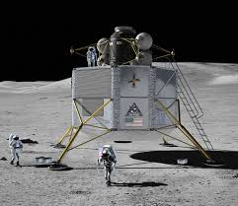
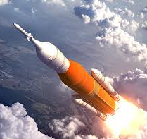
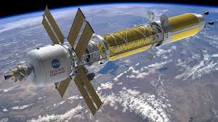
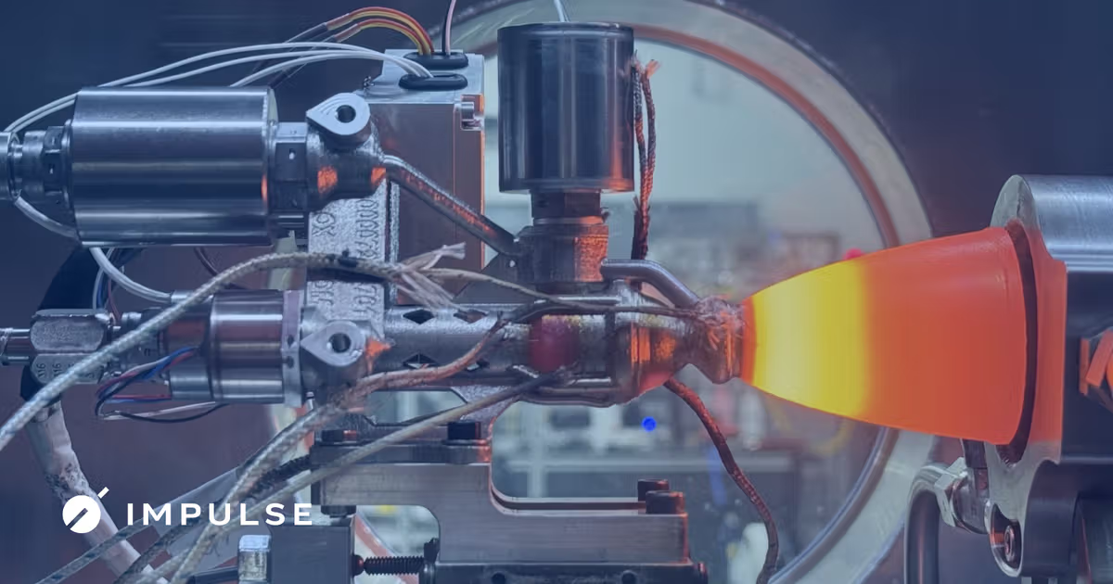
Propulsion
Propulsion systems are required for all transportation needs:
  Attitude control
  Landing / ascent
  Orbit transfer
  Orbit control
  Orbit injection
Types of Propulsion Systems
  Chemical
  Electrical
  Photonic
  Nuclear
Moon Lander
Mars Transfer Vehicles
Rockets
Thruster Mechanisms
40

Slide 41
References and Further Reading
Open sources used in this session. Worth returning to after the course.
NASA State-of-the-Art report
https://www.nasa.gov/smallsat-institute/sst-soa
Guidance, navigation and control chapter
ESA Web TV — CubeSats
https://www.esa.int/ESA_Multimedia/Keywords/System/CubeSats/(result_type)/videos
Mission and deployment footage, over fifty videos
CubeSat integrated ADCS units
https://www.cubesatshop.com/product-category/integrated-adcs/
What a complete commercial ADCS looks like, and what it costs
ECSS
https://ecss.nl/
Control engineering and pointing standards
Pointing and Attitude Control
41
Notes:
Every link is a public, maintained source. The NASA State-of-the-Art report is the single most useful reference for anyone continuing this work.

Slide 42
Control Methods & Pointing Accuracy
Control techniques can be divided into passive methods, if they do not require power, and active methods.
APPROACH
TYPE
POINTING ACCURACY
HOW IT WORKS
Gravity gradient
Passive
± 5°
Useful for low altitude satellites; it makes use of the gravity gradient perturbation to remain in a stable configuration.
Magnetic passive
Passive
± 5°
Useful for simple satellites in equatorial orbits; permanent magnets on board align the spacecraft with the Earth magnetic field.
Spin stabilization
Hybrid
± 1° to ± 0.1°
Used for cylindrical satellites; the satellite is slowly spinning, 20 to 90 rpm, gaining thus gyroscopic stiffness.
Momentum bias
Active
± 0.15° to ± 0.05°
Only one momentum wheel, rotating at high velocity. Similar to a spin satellite, but in this case only the wheel is spinning.
Zero momentum
Active
± 0.15° to ± 0.05°
Three reaction wheels counteract the external torques by varying their velocity, one for each satellite axis. Usually four are used, to increase redundancy.
Quoted sentence: NASA SSRI Knowledge Base, A Brief Survey of Attitude Control Systems for Small Satellites — s3vi.ndc.nasa.gov/ssri-kb
Pointing and Attitude Control
42
Notes:
The accuracy column is the useful one. Point out the two orders of magnitude between passive and active three-axis control, and that a requirement written a little tighter than necessary can change the entire spacecraft. The closing panel answers the question the first row always provokes. The same double role applies to the magnetic interaction, one row below.

Slide 43
Selecting an ADCS: a worked example
We want to design an ADCS subsystem for a CubeSat, around 20 x 20 x 30 cm. The scope of the mission is to use an optical payload to obtain images of the stars and distant galaxies.
THE REQUIREMENT
Control technique
0.1°
Zero momentum with reaction wheels and magnetorquers
Passive methods reach only ± 5°, and every type of wheel needs to be desaturated.
The required pointing accuracy is around 0.1 degrees. The orbit will be at 550 km altitude.
Sensors
Star tracker and magnetometer
Star sensors are the most precise; magnetometers are usually used with magnetorquers.
QUESTION
Considering the external torques, which maximum actuator torque do you choose: 3 x 10⁻⁴, 3.53 x 10⁻⁴, 5.3 x 10⁻⁴ or 4 x 10⁻¹ Nm?
Pointing and Attitude Control
43
Notes:
This is Lecture 08's own mission analysis, with its two multiple-choice questions. Run it as a decision the room makes rather than a result they are shown: offer the options, take a vote, then reveal. The torque question is the fourth of the Lecture 08 options; the point is that the actuator has to exceed the worst-case total without being wildly oversized.

Slide 44
Exercise 4 — Attitude Control Selection
Fifteen minutes, in your team, on the design sheet.
10 min
THE TASK
POINTING ACCURACY BY METHOD
State the pointing accuracy your imaging payload requires, and where that number comes from.
Gravity gradient
± 5°
1
Magnetic passive
± 5°
Choose the control technique that meets it, from the five listed, and give the reason.
2
Spin stabilization
± 1° to ± 0.1°
Choose the sensors that support it, and give the reason.
3
Momentum bias
± 0.15° to ± 0.05°
Reaction wheels saturate. Say what desaturates them on your satellite, and what that costs you in mass, power or volume.
Zero momentum
± 0.15° to ± 0.05°
4
Hand back the required pointing accuracy, the control technique and sensor set with reasons, and the desaturation method with its cost.
Pointing and Attitude Control
44
Notes:
The figures are the ones given earlier in this deck. For an imaging payload the mission analysis works to around 0.1°, which rules out the two passive methods and points at zero momentum with reaction wheels. The sensor answer depends on what the team argues: a star tracker gives the accuracy, a magnetometer is needed anyway if magnetorquers do the desaturation. The last part is the one that matters — wheels are always paired with another actuator, usually magnetorquers, and that is mass and power the team has to find in the budget it set in the power exercise.

